Slide 1
Digital Human Avatar Market Size Worth USD 527.58 Billion in 2030
www.emergenresearch.com
Market Size – USD 10.03 Billion in 2020, Market Growth – at a CAGR of 46.4%, Market Trends – Growth of healthcare sector

Slide 2
Our Model
Market Analysis
Financial Analysis
Distribution Channel Analysis
Brand Analysis
Competitor Analysis
Custom Market Intelligence
Product Analysis
Custom Research
www.emergenresearch.com
Risk Analysis
Demand Analysis

Slide 3
Business Plan
Parameters
End Use Analysis
Demand Availability Analytics
Market Entry Strategy
Restructuring & Revival
New Product Strategy
Product Planning / Strategy
SWOT Analysis
Marketing / Distribution Channel
Feasibility
www.emergenresearch.com
Customer Identification Survey
Competitive Landscape / M&A Feasibility
www.emergenresearch.com

Slide 4
Industries We Cater to
Food & Beverages
Power & Energy
Foods & Beverage, Food Ingredients, Food Processing and Equipment, Food Testing and Supply Chain, Health Food and Sports Nutrition, Frozen and Processed Food, Household, Retail
Oil and Gas, Electricity, Energy Storage, Environmental, Renewable Energy
Information and Tech
Automotive Services
Data Security, Cloud Computing, IoT and Digitalization, Robotics, Telecom and Networking, Software and Services, Analytics, Semiconductor, Internet and
E-Commerce
Electric and Hybrid Vehicles, Off Highway and On Highway Vehicles, Aftermarket and Maintenance, Automotive Parts, Interior and Exterior Materials, Automotive electronics and Systems
www.emergenresearch.com
Materials and Chemicals
Pharma & Healthcare
Organic Chemicals, Disinfectants and Preservatives, Adhesives and Sealants, Polymers and Resins, Petrochemicals, Agrochemicals and Fertilizers, Paints and Coatings
Medical Devices, Therapeutics, Biotechnology, Medical Imaging, Healthcare IT, Hospital Management, Diagnostics, Laboratory Equipment, Pharmaceutical
5

Slide 5
Market Summary
The global digital human avatar market size is expected to reach USD 527.58 Billion in 2030 and register a revenue CAGR of 46.4% over the forecast period, according to latest analysis by Emergen Research. Robust global digital human avatar market revenue growth can be attributed to increasing efforts by customer-centric firms to provide emotionally engaging experience to customers. Integration of conversational intelligence of virtual human avatar enables possibility of a scalable interaction between a human being and the avatar, thus allowing directed approach to understand a customer’s needs. Digital human avatars are capable of conversing with customers through text or speech to offer product recommendations. Also, these avatars can help visitors to navigate across a product catalog and proactively mimic a sales person by initiating a conversation in any languages, and subsequently understand consumer preferences via their replies on basis of prebuilt algorithm, in order to provide suitable responses to a customers’ queries.
Request Free Sample Copy@ https://www.emergenresearch.com/request-sample/897
www.emergenresearch.com

Slide 6
Market Summary
Among the product type segments, the interactive digital human avatar segment is expected to register faster revenue CAGR over forecast period. Live human agents, who follow a standard set of queries, are more likely to struggle at forming an interactive environment in terms of personalized approach in comparison to virtual agents, who understand and learn customer behavior in real-time and based on customer inputs, rapidly adapt to create a completely
personalized approach to each customer. Also, other than interacting with customers through tailored queries and replies, digital human avatars can create a personalized consumer specific algorithm for learning the patterns of their selections and choices. Moreover, businesses can deploy these avatars for online training and learning of their staffs.
Among the industry vertical segments, IT & telecommunications segment revenue is expected to register a rapid growth rate over the forecast period. Rising demand for better connectivity services and emergence of 5G technology are key for growth of companies in the telecom sector. However, contact centers are facing immense pressure and are struggling to scale as required. Also, automated technologies such as chatbots that are scalable are unable to replicate crucial human touch in providing customer experience. Thus, customers are experiencing digital fatigue to the point where about 82% of them rather want to talk to a person. Digital human avatars deliver a more human-like experience to customers, enabling telecom firms to scale the human touch, as well as allow human staff to focus on other important tasks.
Request Free Sample Copy@ https://www.emergenresearch.com/request-sample/897
www.emergenresearch.com

Slide 7
Market Summary
Some major companies in the market report include UneeQ, Microsoft Corporation, Didimo Inc., Wolf3D, HOUR ONE AI, Spatial Systems, Inc., CARV3D, DeepBrain AI, Soul Machines, and Synthesia Ltd.
Emergen Research has segmented the global digital human avatar market on the basis of product type, industry verticals, and region:
Product Type Outlook (Revenue, USD Billion; 2018–2030)
Interactive Digital Human Avatar
Non-Interactive Digital Human Avatar
Industry Verticals Outlook (Revenue, USD Billion; 2018–2030)
BFSI
Education
Retail
Healthcare
Automotive
IT & Telecommunications
Gaming & Entertainment
Others
Read More@ https://www.emergenresearch.com/industry-report/plastic-additives-market

Slide 8
Parameter | Details
Market Size Estimation Period | 20212030
Base Year Considered | 2021
Historical Data | 2019-2020
Forecast Period | 2021-2030
Quantitative Units | Revenue in USD million & CAGR from 2020 to 2028
Segments Covered | Types, Application, End-Users, Regions & more.
Countries Included | The U.S., Germany, U.K., Italy, China, India, Japan, Brazil
Report Coverage | Revenue Forecast, Company Ranking, Competitive Landscape, Growth Factors, and Trends
Regions Scope | North America, Europe, Asia Pacific, Latin America, Middle East and Africa
Customization Scope | 10 hours of free customization & expert consultation
Pricing and Purchase Options | Explore Different Purchase Options & Request for Discount to Avail New Year Discount
MARKET SEGMENTATION
www.emergenresearch.com

Slide 9
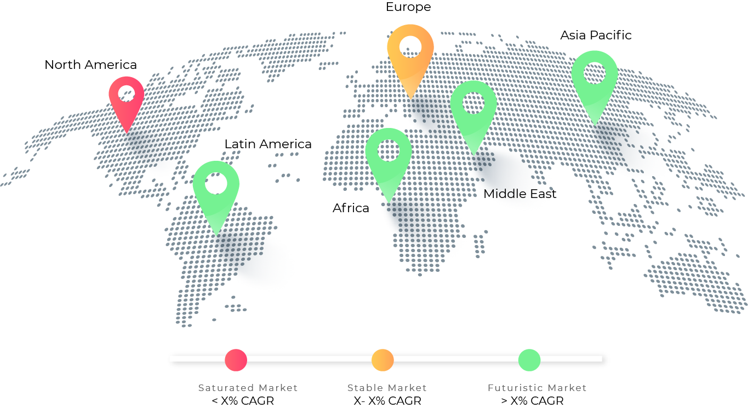
Regional Share Dynamics
www.emergenresearch.com

Slide 10
About Us
At Emergen Research, we believe in advancing with technology. We are a growing market research and strategy consulting company with an exhaustive knowledge base of cutting-edge and potentially market-disrupting technologies that are predicted to become more prevalent in the coming decade.
Our expertise umbrellas the technological environment of all major industries, and our services help you map your actions to ensure optimal yield. Our analysts utilize their market proficiency to offer actionable insights that help our clients implement profitable strategies and optimize their return on investment. Our services are wide-ranging, right from technological environment analysis to technological profiling that highlights the existing opportunities in the market you can capitalize on to stay ahead of your competitors.
www.emergenresearch.com

Slide 11
Lets Talk;
Contact Information
Reach out to us and our Research Executives will ensure you get the report that meets all your requirements and address all your concerns.
14671 110 Avenue, Surrey, British Columbia, V3R2A9
www.emergenresearch.com
www.emergenresearch.com
+1 (604) 757-9756
sales@emergenresearch.com

