Slide 1
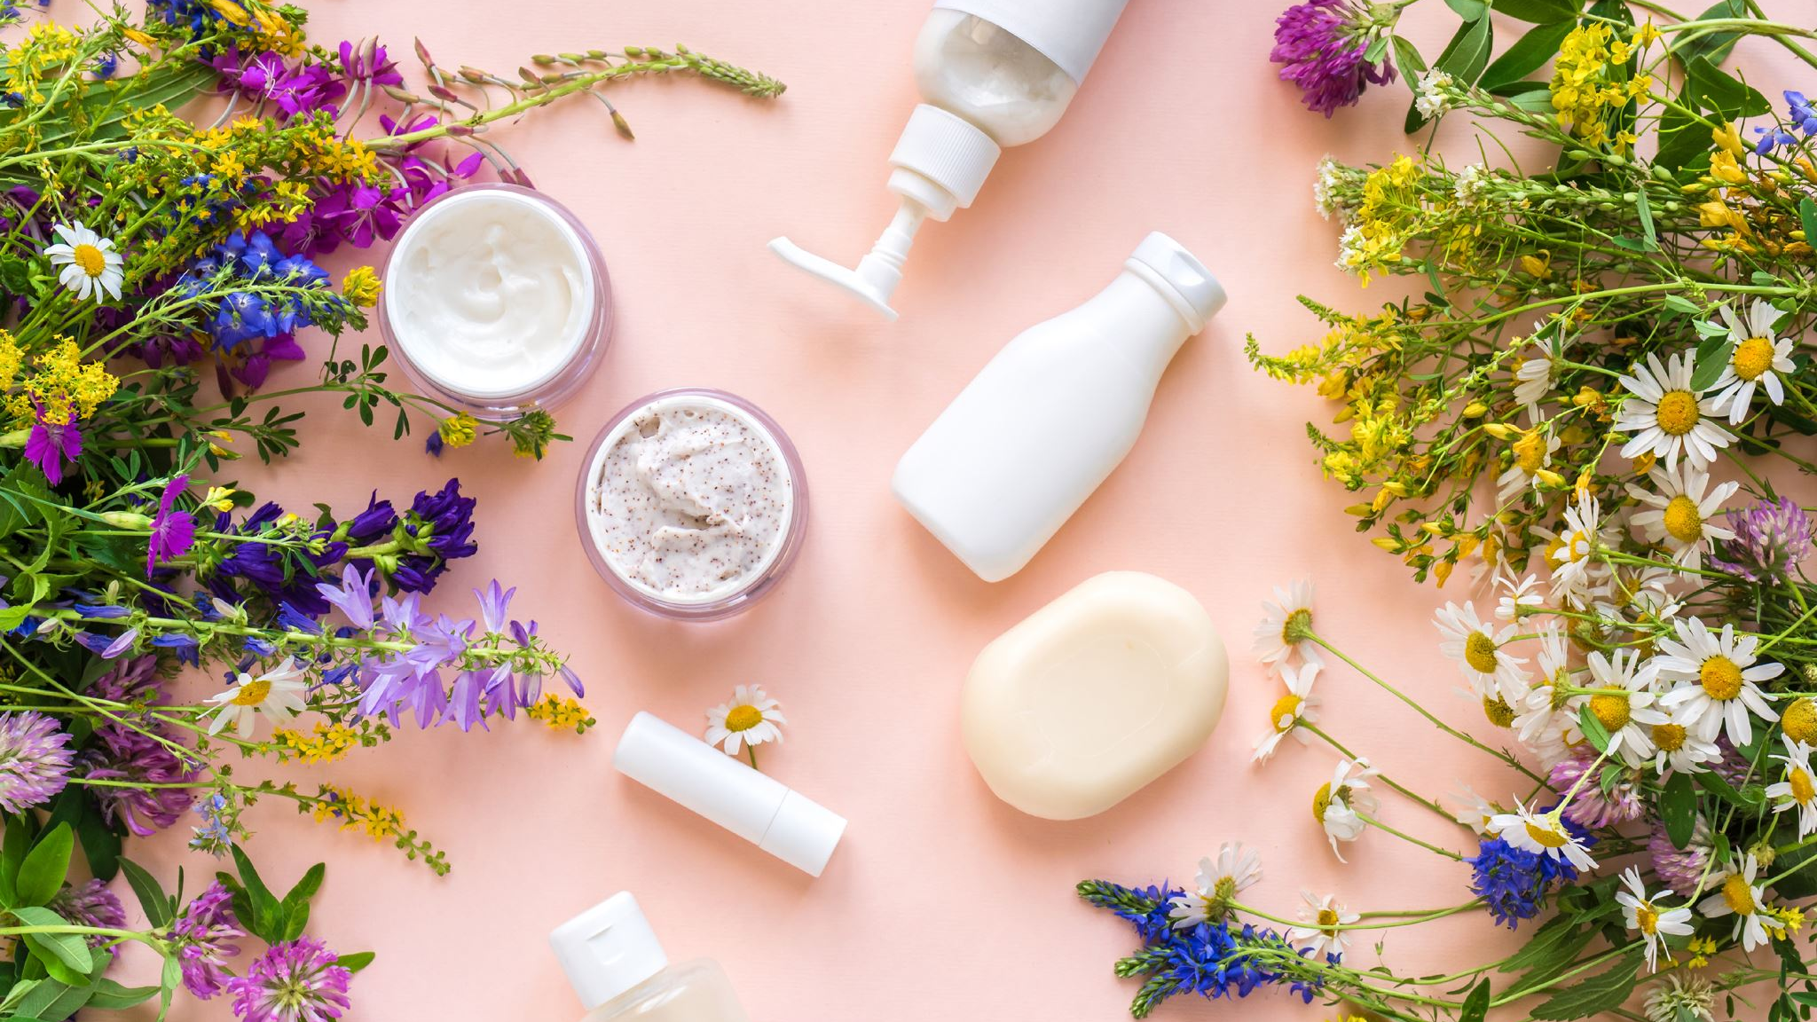
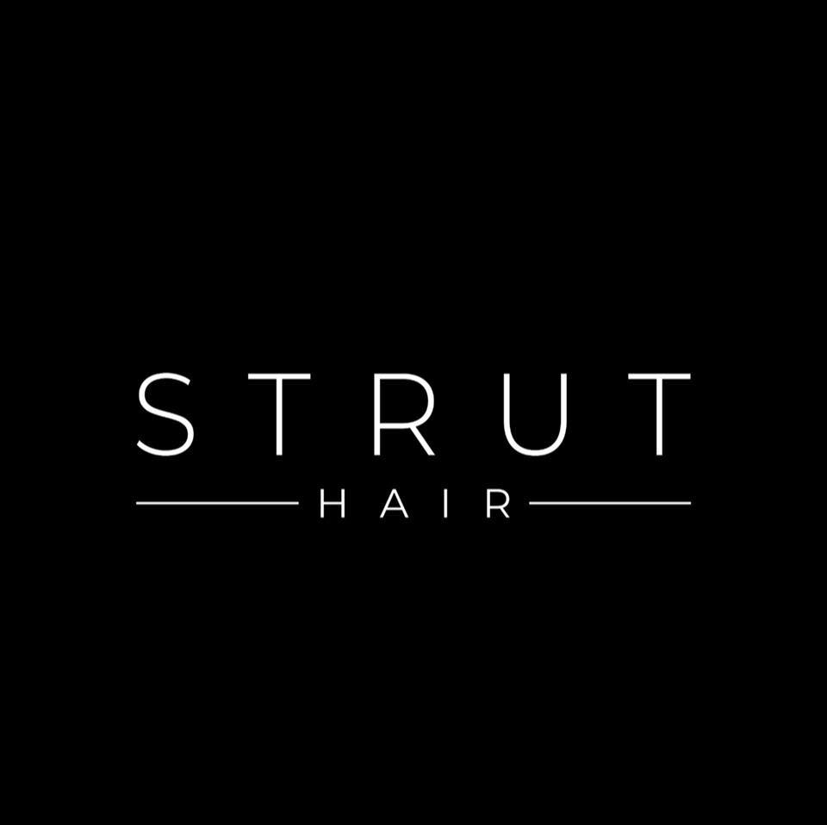
Hair products for oily hairs | Acacia Dental Clinic

Slide 2
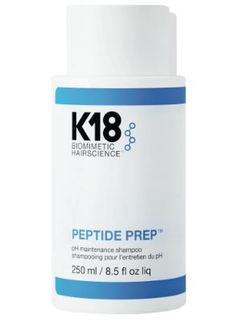
K18 Peptide pH maintenance Shampoo
Your hairs are getting greasy quickly? If yes, then you should try strut products. It will make your hairs oil-free without feeling any type of itching and flaking. Avoid shampoos and conditioners which have too much moisture. Let’s try, shampoo of strut it contains things like tea tree oil, salicylic acid, and many more. It will help you in cleaning of scalp and it also control sebum production. You can keep your Hair products for oily hairs
K18 Hair Mask fans rejoice, their new shampoo range is here and boy, it’s a goodie. This K18 Peptide pH Maintenance Shampoo is perfect for everyday hair washing and has been formulated for an oh-so-gentle cleanse, removing dirt, oil and other impurities without stripping the hair’s natural pH levels. It’s also formulated with the K18 patented peptide which keeps your mane looking and feeling stronger, healthier and softer. So gentle, you can use it every day, expect your hair to feel hydrated, nourished and squeaky clean.

Slide 3
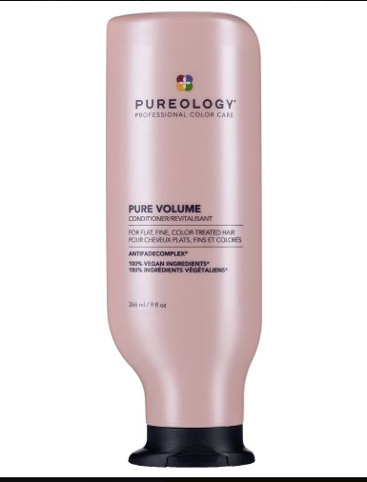
Pure Volume Shampoo
Pureology Pure Volume Shampoo is a gentle volumizing shampoo for sensitized color-treated hair, the Pureology Extra Care Shampoo contains lightly balanced cationic polymers to remove volume inhibiting buildup and oil but won’t remove natural oils and color.

Slide 4
About us
Strut Hair Care are here to meet all your needs, our customers are our priority.
Our websites sells 100% authentic products and brands.
Subscribe to us for amazing deals and receive 10% off your first order.
Follow us on Facebook and Instagram for hair tips, promos & giveaways!
9 Somers Parade, Altona, VIC 3018
0410 055 257
struthaircare@gmail.com

