Slide 1
Pest Control Services in Bhubaneswar by TechSquadTeam
Creating a Pest-Free Environment for Homes and Businesses
techsquadteam.com

Slide 2
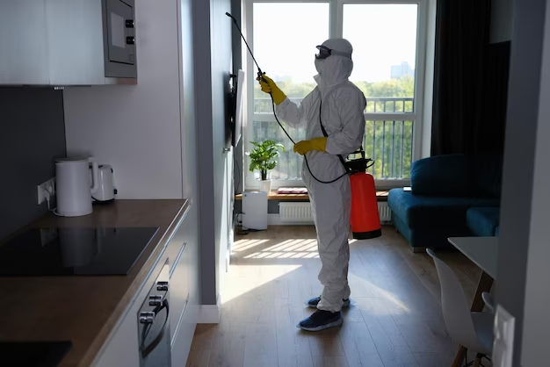
Welcome to the Pest Control Services in Bhubaneswar presentation.
Techsquadteam provide comprehensive pest management solutions to ensure a pest-free environment for homes and businesses.
Our services are designed to tackle a wide range of pests effectively.
techsquadteam.com

Slide 3
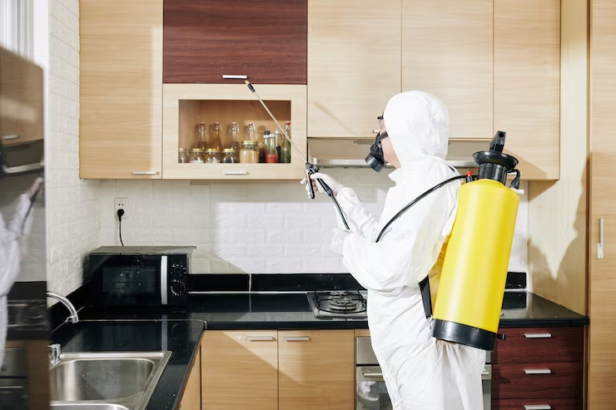
Why Pest Control?
Pests can cause health risks, damage property, and disrupt daily life.
Effective pest control is essential to maintain hygiene and protect investments.
techsquadteam.com

Slide 4
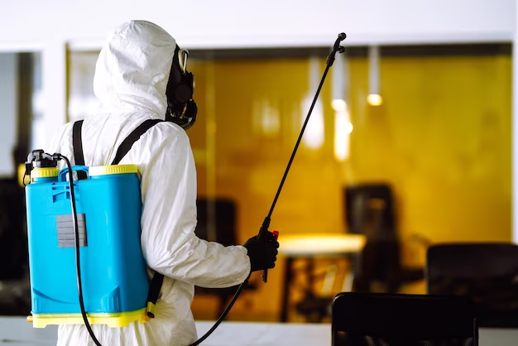
Our Approach
Inspection: Thorough assessment of the premises to identify pest types and infestation levels.
Treatment: Implementation of safe and effective pest control measures.
Monitoring: Regular follow-ups to ensure long-term pest management.
techsquadteam.com

Slide 5
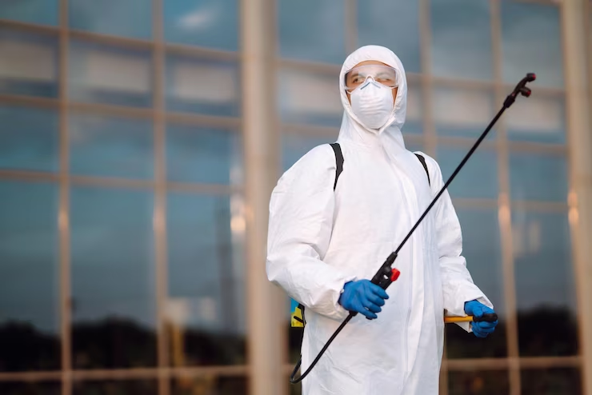
Common Pests in Bhubaneswar
Termites: Destructive pests causing structural damage.
Cockroaches: Carriers of diseases and allergens.
Mosquitoes: Transmit diseases like dengue, malaria, and Zika virus.
techsquadteam.com

Slide 6
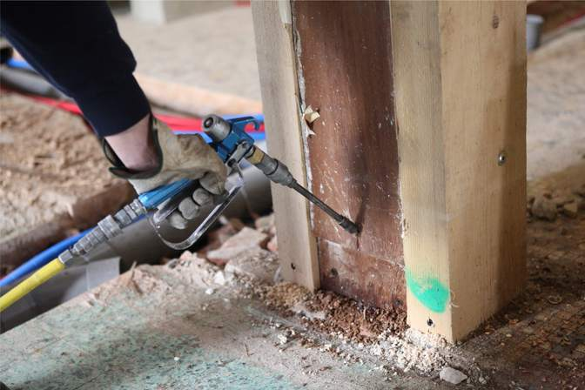
Termite Control:
Soil treatment and barrier installation.
Wood treatment to prevent termite infestation.
techsquadteam.com

Slide 7
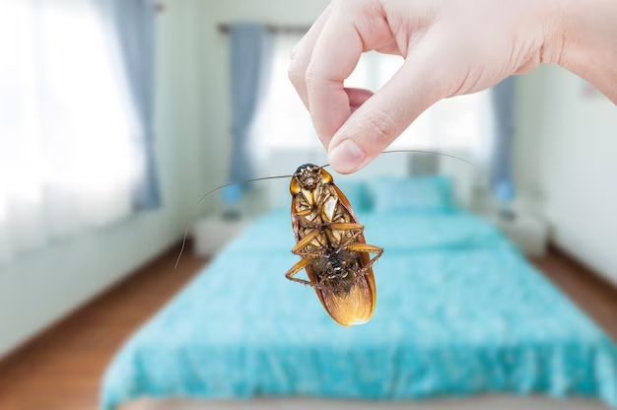
Cockroach Control:
Gel baits and residual sprays to eliminate cockroaches.
Focus on hiding spots and breeding areas.
techsquadteam.com

Slide 8
Rodent Control:
Trapping and baiting to reduce rodent population.
Exclusion measures to prevent entry.
techsquadteam.com

Slide 9
Ant Control:
Identification of ant species for targeted treatment.
Barrier application to deter ants.
techsquadteam.com

Slide 10
Bedbug Control
Steam treatment and insecticides to eliminate bedbugs.
Mattress and upholstery treatment.
techsquadteam.com

Slide 11
Eco-Friendly Approach
We prioritize the safety of your family, pets, and the environment.
Use of low-toxicity, eco-friendly products.
Minimize chemical usage while ensuring effective results.
techsquadteam.com

Slide 12
Our Team
Experienced and certified pest control professionals.
Knowledgeable about local pest behavior and trends.
Committed to providing the best solutions.
techsquadteam.com

Slide 13
Customer Benefits
Peace of Mind: A pest-free living and working environment.
Health Protection: Reduction in disease-carrying pests.
Property Preservation: Prevention of structural damage.
Convenience: Regular monitoring and follow-ups.
techsquadteam.com

Slide 14
Why Choose Us?
Highly Trained and Experienced Pest Exterminators:
Environmentally-Friendly Products:
Effective and Long-Lasting Treatment:
Guaranteed Quality Service at the Best Price:
techsquadteam.com

Slide 15
Thank You
We are dedicated to creating a pest-free environment for you.
Contact us for effective and reliable pest control services in Bhubaneswar.
Contact Us
Bhubaneswar, Odisha, 751010
Web: techsquadteam.com
PH: 07795001555
WA: 9937386771
Email: support@techsquadteam.com
techsquadteam.com

