Slide 1
Restaurant in Redcliffe Brisbane
Little lamb restaurant
Little Lamb Restaurant

Slide 2
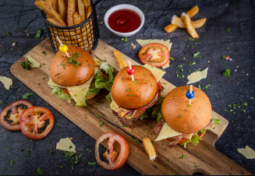
Little lamb restaurant
Spanish food restaurants in Redcliffe are regarded as culinary gems all over the world and are also known for their strong tastes, vivid colors, and uniqueness. Spanish food offers an enticing taste of flavors and textures because of its rich culinary traditions and influences from many different civilizations. Spanish dishes are created with fresh and quality ingredients. We have a team of skilled and experienced chefs who are always ready to provide delicious and high-quality food with locally sourced and fresh ingredients. Authentic Mediterranean cuisine is always available at a little lamb restaurant in Redcliffe, Brisbane. So you don’t need to worry about your food taste. There are several items on the menu with a backstory that draws on our love of food and collective experiences. Quality and presentation of our food are hallmarks of our offering. We offer you a great variety of Spanish food. Your ordered meals will enhance our exceptional skill, which includes a great diversity and complexity of textures.

Slide 3
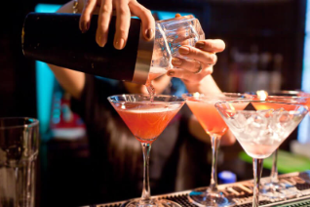
Little lamb restaurant
The menu features a lot of Spanish and Mediterranean cuisine with flavors that are distinctive and creative. Food flavor improved with the application of modern techniques. The wine list of our Little Lamb restaurant in Brisbane is excellent and nicely matched to the cuisine. Restaurant in Redcliffe Brisbane We have a facility bar that provides you with tasty and creative red wine and white wine made up of remarkable and broad-ranging ingredients. By using creative presentations and new flavors, our skilled chefs go above and beyond to make delectable dishes that capture the hearts of our customers. To create recipes that are as much about balance as they are about the variety of flavors and textures, unusual and exceptional ingredients are collected from all around Australia.

Slide 4
Little lamb restaurant
Spanish food in our restaurant is based on high-quality ingredients and straightforward cooking methods to create dishes with a taste balance. While the flavor profile differs from place to place, many characteristics are universal. The strong taste of garlic, paprika, saffron, and olive oil is frequently found in Spanish cuisine. Spanish Restaurant in Brisbane With a liberal use of fresh herbs like parsley, thyme, and rosemary, the dish achieves a delicate balance between savory and acidic tastes. It will bring enjoyment to your tongue, heart as well as soul. Spanish cooking emphasizes showcasing the best products to create dishes that are flavorful, bright, and incredibly filling. We are committed to making customers satisfied and happy by providing them with high-quality and delicious food. Customers are our priority. We always try to never disappoint in the taste of food. You can reserve your table by contacting us, and order your food using the online application.

